Slide 1

Python Introduction
Malleswar Yenugu, PhD

Slide 2
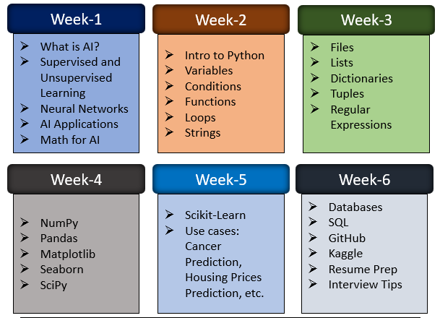
Course Outline

Slide 3
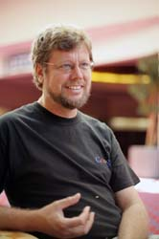
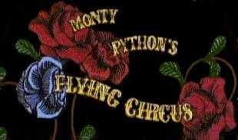
About Python
Python is the language of the Python developed by Guido van Rossum.
Python is an object/script/functional oriented programing language.

Slide 4
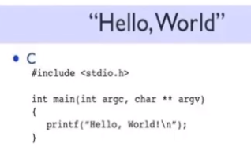
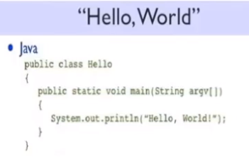
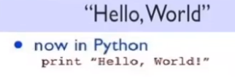
Why Python
Open Source
Syntax is simple as English
Very large and collaborative developer community
Extensive packages for Data science packages like Scikit-learn, Pandas, etc.

Slide 5
Python for Data Science
There are several reasons to learn Python. Some of them are as follows -
Python runs well in automating various steps of a predictive model.
Python has awesome robust libraries for machine learning, natural
language processing, deep learning, big data and artificial Intelligence.
Python wins over R when it comes to deploying machine learning models in production.
It can be easily integrated with big data frameworks such as Spark and Hadoop.
Python has a great online community support.

Slide 6



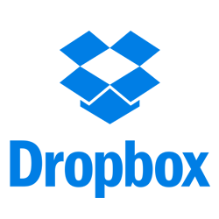
Do you know the following sites are developed in Python?

Slide 7
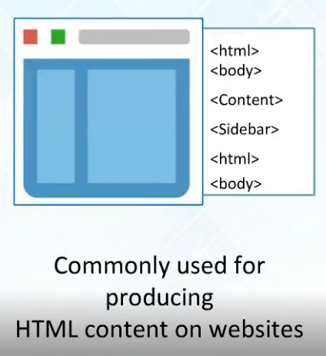
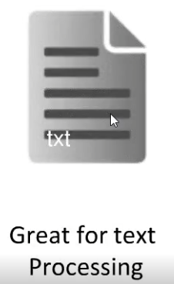
Applications of Python
System administration
Scientific computing
Text processing
Image processing
Documentation
Graphical user interfaces
Web frameworks
Multimedia
Databases
Networking
Test frameworks
Automation
Web scraping
(Pandas Library)

Slide 8
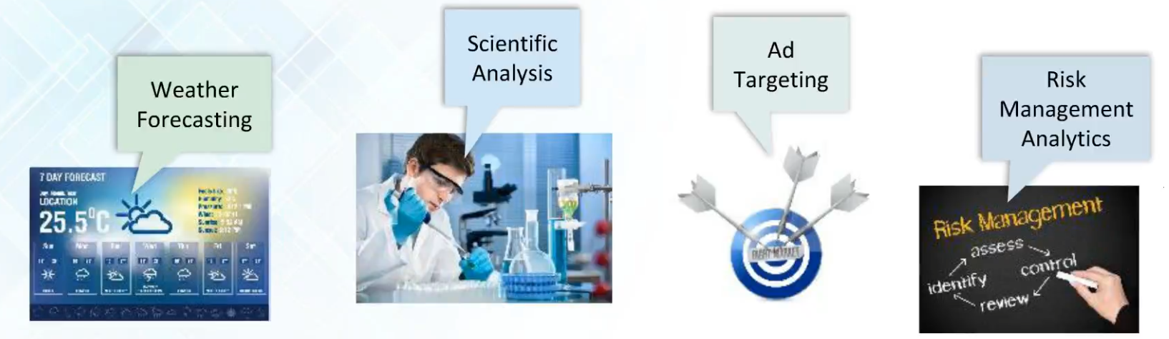
Applications of Python in Data Analytics

Slide 9
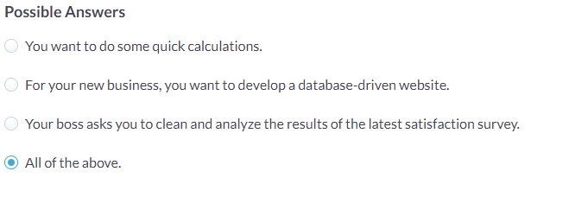
When to use Python?

Slide 10
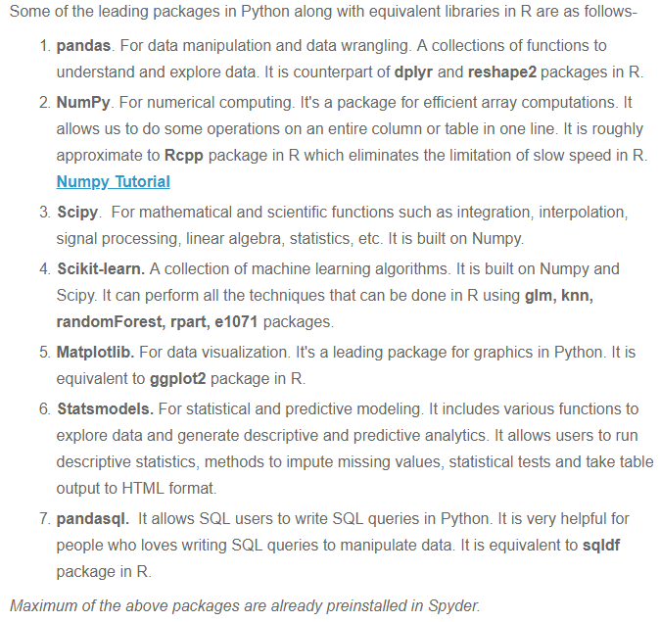
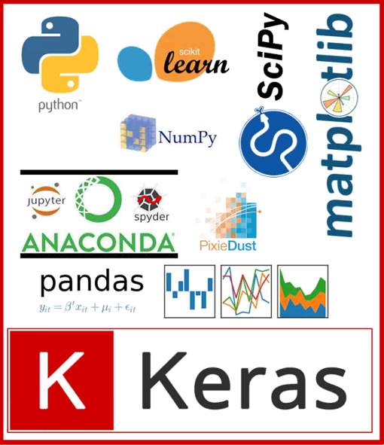
Python packages for Data Analysis and Visualization
(For Deep Learning)

Slide 11
Early Learner: Syntax Errors
We need to learn the Python language so we can communicate our instructions to Python. In the beginning we will make lots of mistakes and speak gibberish like small children.
When you make a mistake, the computer does not think you are “cute”. It says “syntax error” - given that it knows the language and you are just learning it. It seems like Python is cruel and unfeeling.
You must remember that you are intelligent and can learn. The computer is simple and very fast, but cannot learn. So it is easier for you to learn Python than for the computer to learn English...

Slide 12
Elements of Python
Vocabulary / Words - Variables and Reserved words
Sentence structure - valid syntax patterns
Story structure - constructing a program for a purpose

Slide 13
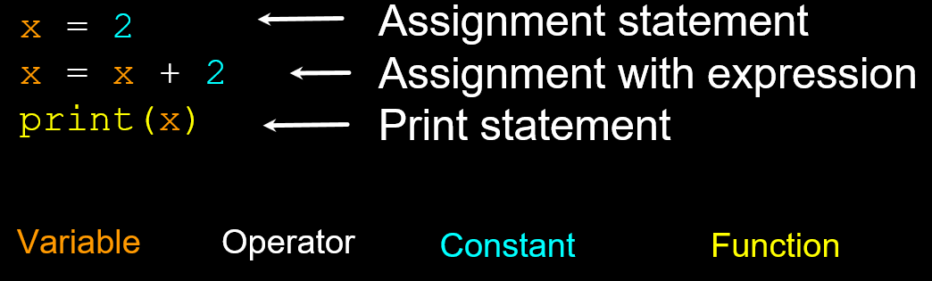
Sentences or Lines

Slide 14

Python Scripts
Interactive Python is good for experiments and programs of 3-4 lines long.
Most programs are much longer, so we type them into a file and tell Python to run the commands in the file.
In a sense, we are “giving Python a script”.
As a convention, we add “.py” as the suffix on the end of these files to indicate they contain Python.

Slide 15
Interactive vs. Script
Interactive
- You type directly to Python one line at a time and it responds
Script
- You enter a sequence of statements (lines) into a file using a text editor and tell
Python to execute the statements in the file

Slide 16
Program Steps or Program Flow
Like a recipe or installation instructions, a program is a sequence of steps to be done in order.
Some steps are conditional - they may be skipped.
Sometimes a step or group of steps is to be repeated.
Sometimes we store a set of steps to be used over and over as needed several places throughout the program.

Slide 17
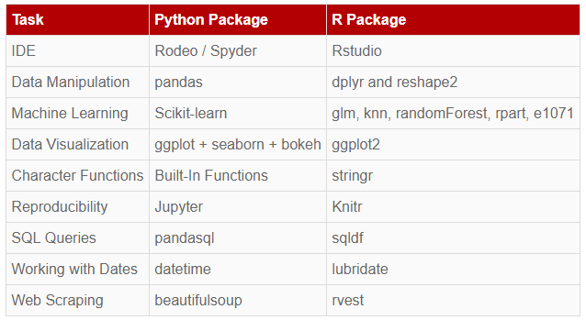
Python vs. R

